Slide 1
Meconium Aspiration Syndrome in Infants
Name of Author:
Institution:
Date:

Slide 2
Objectives
Definition & Causes
Pathophysiology
Clinical Manifestation
Treatment and Management
Equipment Used

Slide 3
Definition & Causes
Meconium – a dark green fecal material that is produced in the intestinal organs of fetuses.
Meconium aspiration syndrome (MAS) occurs when the meconium mixed with amniotic fluid, gets inhaled (Raju et al., 2010: Goel and Nangia, 2016).
Causes include;
- Uteral stress & labor contractions
- Poor blood flow/low oxygen levels
- infections
MAS is usually mild by severe cases can lead to further complications.
Notes:
The mixing of the meconium with the amniotic fluid could pose significant danger to the fetus as it inhales. This brings about the Meconium aspiration syndrome
Severe MAS: infant placed on assisted ventilation for over 48 hours & linked to persistent pulmonary hypertension of newborn (PPHN).
Mild MAS is where one requires less than 40 percent oxygen in a period less than 48 hours (Swarnam et al., 2012).

Slide 4
Pathophysiology
MAS is linked to
Complete or partial obstruction to the respiratory system
Surfactant dysfunction or inactivation (Swarnam et al., 2012).
Chemical pneumonitis
Bacterial growth in the uterus + increased risk for intra-amniotic infections (Goel, and Nangia, 2016).
It triggers persistent pulmonary hypertension of newborn (PPHN) (Swarnam et al., 2012).
Notes:
The pathophysiology of MAS has not been completely explained and it is largely due to the complex make-up of meconium. It includes among others intestinal and pancreatic secretions, bile pigments, blood, amniotic fluid, desquamated cells, and vernix caseosa (Goel, and Nangia, 2016). Thus, it has not been possible to tie down a single agent as responsible for MAS’ pathophysiology (Lindenskov et al., 2015).

Slide 5
Clinical Manifestation
Respiratory Distress Symptoms
Fast-paced or labored breathing
Grunting sounds
Nasal flaring
Chest retractions
- Roofthooft et al., (2011)
Other Symptoms
Weight loss
Low Apgar Score
Body limpness
Skin Peeling
Bluish discoloration on nails and vernix
Notes:
There are a wide range of symptoms associated with the meconium aspiration syndrome

Slide 6
Treatment and Management
Performing amnioinfusion- to dilute meconium in the uterus with a sterile fluid (Balest, 2020).
Intrapartum pharyngeal sanctioning- to suck out meconium material in the mouth, nose and respiratory duct (Goel, and Nangia, 2016).
Chest physiotherapy by gently tapping an infant’s chest.
Administering synthetic surfactant to support breathing.
Antibiotics to keep out infections (Swarnam et al., 2012).
Close observation in the neonatal intensive care unit (Dargaville, 2012).
Notes:
Proper diagnosis would inform better pharmacological and non-pharmacological interventions to treat MAS among infants.

Slide 7
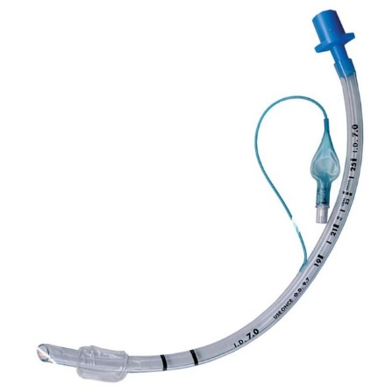
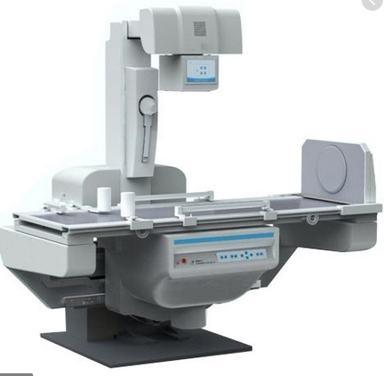
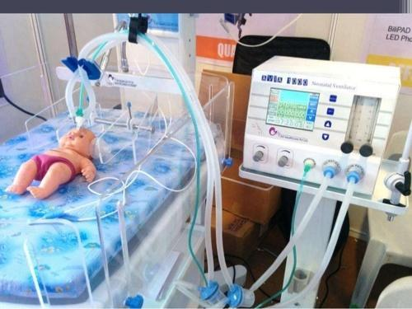
Equipment Used
3.5mm Endotracheal Tube
X-ray
Ventilator

Slide 8
References
Balest, A. (2020). Meconium Aspiration Syndrome. Retrieved on 27 November 2020 from https://www.msdmanuals.com/home/children-s-health-issues/lung-and-breathing-problems-in-newborns/meconium-aspiration-syndrome
Burke, D. (2018). Meconium Aspiration Syndrome. Health line. Retrieved on 27 November 2020 from https://www.healthline.com/health/meconium-aspiration-syndrome
Dargaville, P. (2012). Respiratory Support in Meconium Aspiration Syndrome: A Practical Guide. Int’l Journal of Pediatrics, Article 965159, 11-17 Doi: 10.1155/2012/965159
Goel, L., & Nangia. S. (2016). Meconium aspiration syndrome: challenges and solutions. Research and Reports in Neonatology, 7, 19—28 Doi: 10.2147/RRN.S78106
Lindenskov, P., Castellheim, A., Saugstad, D., & Mollnes, T. (2015). Meconium aspiration syndrome: possible pathophysiological mechanisms and future potential therapies. Neonatology, 107(3):225-30. Doi: 10.1159/000369373.
Raju, U., Sondhi, V., & Patnaik, S. K. (2010). Meconium Aspiration Syndrome: An Insight. Medical journal, Armed Forces India, 66(2), 152–157. https://doi.org/10.1016/S0377-1237 (10)80131-5
Roofthooft, M., Elema, A., Bergman, K., and Berger, R. (2011). Patient Characteristics in Persistent Pulmonary Hypertension of the Newborn. Clinical Study | Open Access, 2011 |Article ID 858154. Doi: 0.1155/2011/858154
Swarnam, K., Soraisham, A. S., & Sivanandan, S. (2012). Advances in the management of meconium aspiration syndrome. International journal of pediatrics, 2012, 359571. https://doi.org/10.1155/2012/359571

